Slide 1

Farm Droid
An Autonomous Agricultural Robot Proposal

Slide 2

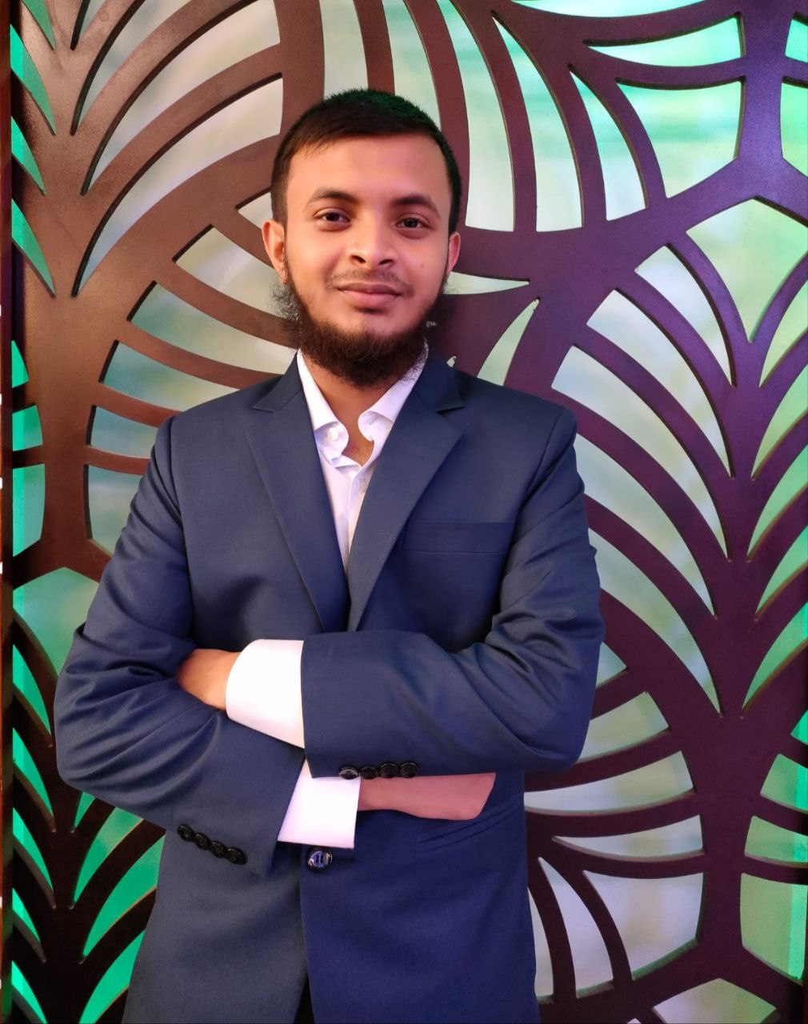
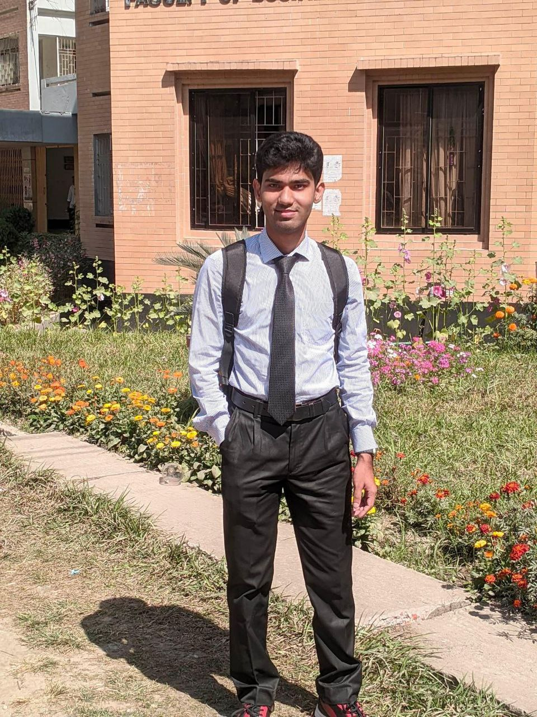
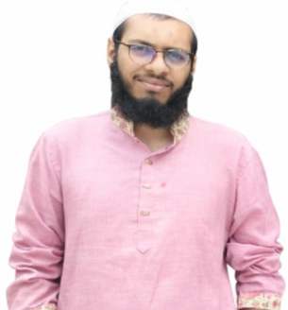
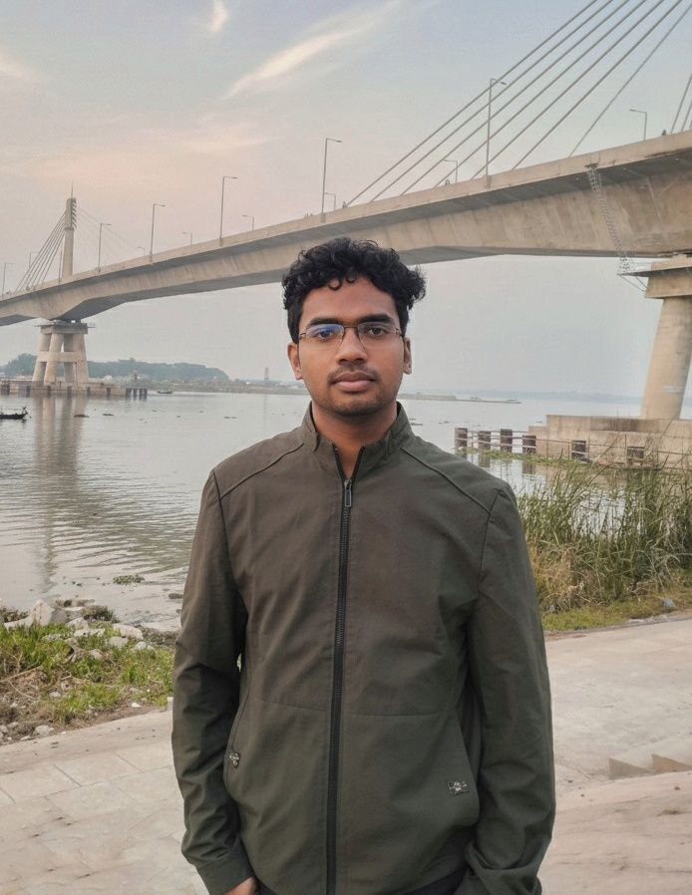
Project Title : Farm Droid
Group-1
Name: Md. Abu Taher
ID No: 2102003
Reg No: 10130
Session: 2021-22
Level-III, Semester-II
Name: MD. SADMAN KABIR
BHUIYAN
ID No: 2102020
Reg No: 10147
Session: 2021-22
Level-III, Semester-II
Name: Sharafat Karim
ID No: 2102024
Reg No: 10151
Session: 2020-21
Level-III, Semester-II
Name: Mehedi Hasan
ID No: 2102007
Reg No: 10134
Session: 2021-22
Level-III, Semester-II
Name: MD SAFIULLAH
FORAJY
ID No: 2102051
Reg No: 10178
Session: 2020-21
Level-III, Semester-II

Slide 3











Project Objectives
Autonomous Navigation
Adaptive Mobility
Computer Vision
Monitoring
Integrate sensors for measuring soil moisture, pH levels, and weather conditions.
Implement GPS-based pathfinding to travel to specific field coordinates independently.
Develop a robust rover system capable of traversing uneven agricultural terrain.
Utilize OpenCV to recognize crops, weeds, and obstacles in real-time.

Slide 4


System Architecture
The system adopts a "Distributed Computing" architecture to handle computational loads efficiently.
The Brain: Raspberry Pi 4
The Controller: Arduino/ESP32
•
Handles high-level logic and path planning.
•
Dedicated to real-time operations.
•
Processes visual data using OpenCV.
•
Generates PWM for motor drivers.
•
Communicates via Serial/I2C.
•
Reads analog sensor data.
•
Language: Python.
•
Language: C++.

Slide 5

Mandatory Components & Modules:
Controllers
Raspberry Pi 4 Model B (4GB): 14,100 BDT
Arduino Uno R3: 988 BDT
ESP-32 Development Board (×2): 1,100 BDT
Motors & Drivers
MG995 Servo (×8): 6,160 BDT
DS3218 20KG Servo (×2): 4,700 BDT
MG996R Servo (×2): 780 BDT
SG90 Micro Servo (×4): 600 BDT
PCA9685 Servo Driver (×2): 894 BDT
Sensors
GPS, LiDAR, IMU, Encoders, Pressure, PIR, Ultrasonic, IR, Camera
Total Sensors Cost: 4,978 BDT
Power & Audio , Mechanical & Misc
Power & Audio Modules: 356 BDT
Mechanical Parts & Wiring: 4208 BDT
Tools
Digital Scale & Hex Saw: 274 BDT
Total Cost:
39138 BDT

Slide 6
Data Flow Methodology
Environment Input: The robot interacts with the physical world, collecting raw data from the field.
Data Acquisition: Arduino/ESP32 collects data from Soil, Rain, and Temperature sensors. The Camera captures visual streams.
Processing: The Raspberry Pi processes visual data (OpenCV) for object detection and receives sensor readings via I2C/UART.
Decision Making: Path planning algorithms determine the next move based on obstacle detection and GPS coordinates.
Physical Action: Motor commands are sent back to the Controller to drive the actuators and servo arm.

Slide 7
Technology Stack:
Language: Python (Vision/Logic), C++ (Arduino Firmware)
Vision: OpenCV, TensorFlow Lite (Optional for object detection)
Hardware Interface: I2C (Inter-Integrated Circuit), UART (GPS)
Power Management: LiPo Batteries with Buck Converters (UBEC) for system stability.
Hardware Components:
Actuators: DC Gear Motors or MG996R Servos (Mobility), SG90 (Gripper/Arm).
Sensors: NEO-6M GPS, Ultrasonic (HC-SR04), Soil Moisture, Rain Sensor, DHT11.
Controllers: Raspberry Pi 4 Model B (4GB), Arduino Uno / ESP32.
Drivers: PCA9685 PWM Driver (for Servos) or L298N/Motor Driver (for Wheels).
Vision: Official Raspberry Pi Camera Module / USB Webcam.

Slide 8
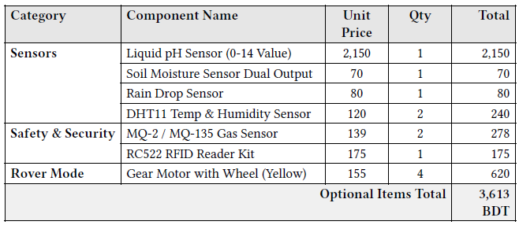
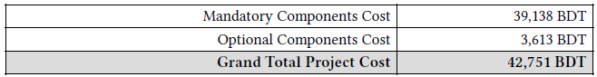
Optional Components & Modules:
Project Financial Summary:

Slide 9
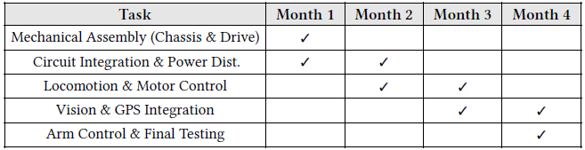
Work Plan (Timeline):
Circuit Diagram:

Slide 10
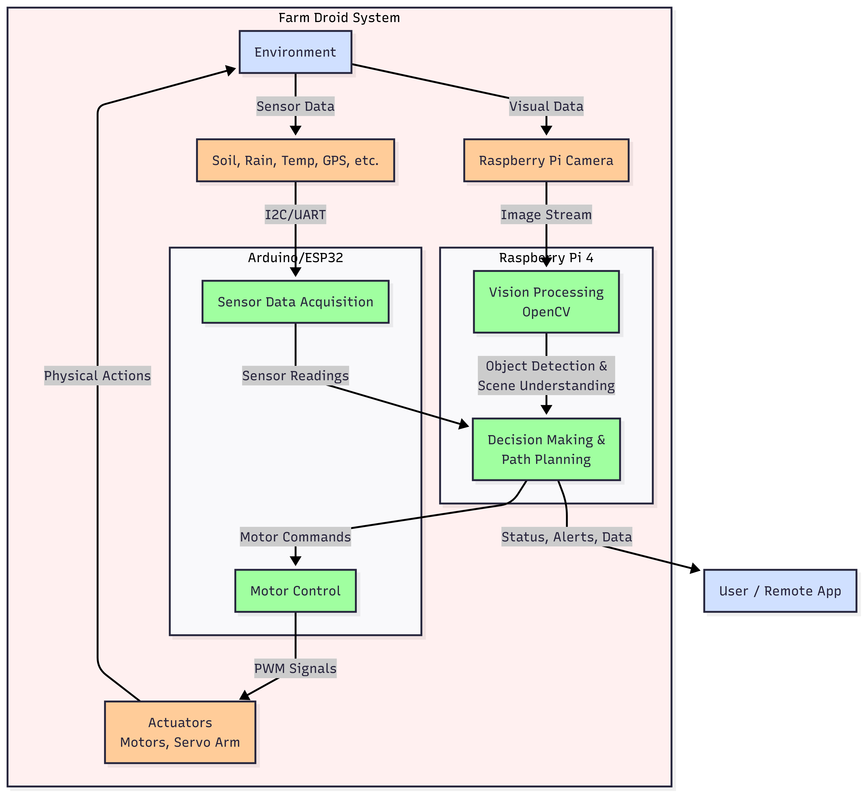

Slide 11
Thank You!
Any Questions?

Slide 12
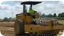
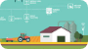
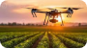
Image Sources
https://mintekresources.com/wp-content/uploads/2023/04/Padfood-Roller-Compacting-Lime-Treated-Soil-e1681320292833.webp
Source: mintekresources.com
https://insidetelecom.com/wp-content/uploads/2020/10/smart-farming3.jpg
Source: insidetelecom.com
https://static.vecteezy.com/system/resources/previews/056/647/741/non_2x/a-drone-flies-over-a-field-at-sunset-highlighting-agricultural-technology-and-precision-farming-in-a-vibrant-landscape-photo.jpeg
Source: www.vecteezy.com

